Slide 1
UNIT 5 For Live Session Assignment
Analysis of Variance
(Comparing 3 or more means)

Slide 2
Archeology in New Mexico
An archeological dig in New Mexico yielded four sites with lots of artifacts. The depth (cm) that each artifact was found was recorded along with which site it was found in.
The researcher has reason to believe that sites 1 and 4 and sites 2 and 3 may be similar in age. In theory, the deeper the find, the older the village.
Is there any evidence that sites 1 and 4 have a mean depth that is different than the mean depth of artifacts from sites 2 and 3?

Slide 3
Archaeology Example
Depth | Site |  | Depth | Site |  | Depth | Site |  | Depth | Site
93 | 1 |  | 85 | 2 |  | 100 | 3 |  | 96 | 4
120 | 1 |  | 45 | 2 |  | 75 | 3 |  | 58 | 4
65 | 1 |  | 80 | 2 |  | 65 | 3 |  | 95 | 4
105 | 1 |  | 28 | 2 |  | 40 | 3 |  | 90 | 4
115 | 1 |  | 75 | 2 |  | 73 | 3 |  | 65 | 4
82 | 1 |  | 70 | 2 |  | 65 | 3 |  | 80 | 4
99 | 1 |  | 65 | 2 |  | 50 | 3 |  | 85 | 4
87 | 1 |  | 55 | 2 |  | 30 | 3 |  | 95 | 4
100 | 1 |  | 50 | 2 |  | 45 | 3 |  | 82 | 4
90 | 1 |  | 40 | 2 |  | 50 | 3
78 | 1 |  |  |  |  | 45 | 3
95 | 1 |  |  |  |  | 55 | 3
93 | 1
88 | 1
110 | 1

Slide 4
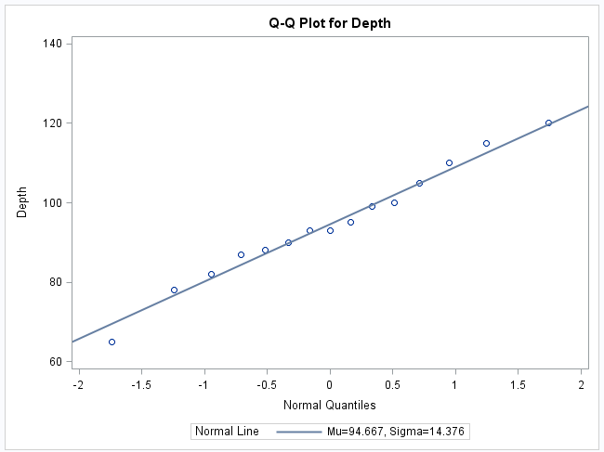
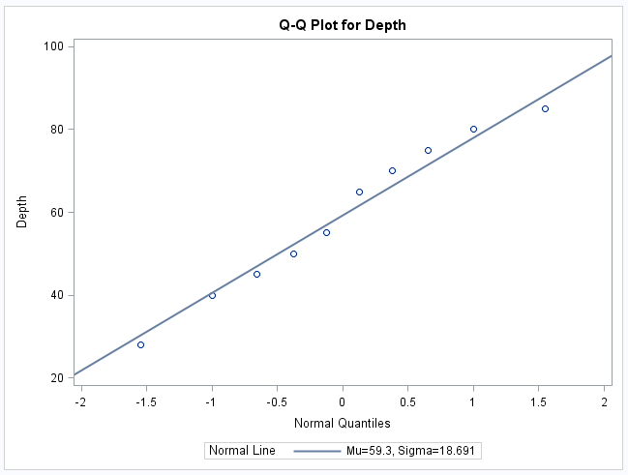
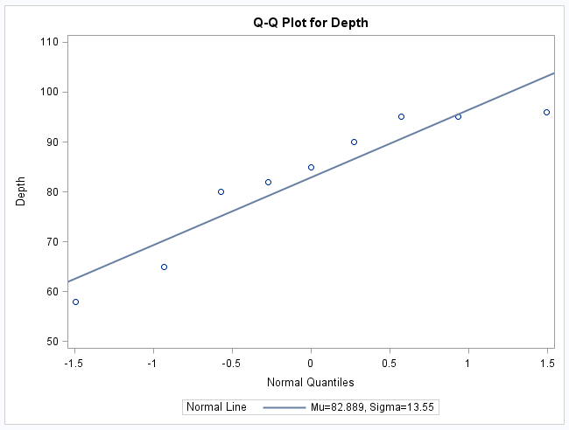
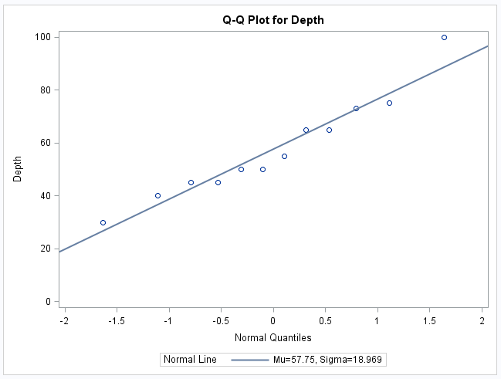
Archeology Example Assumptions: Normality
Site 1
Site 2
Site 4
Site 3
Histograms will be helpful as well!

Slide 5
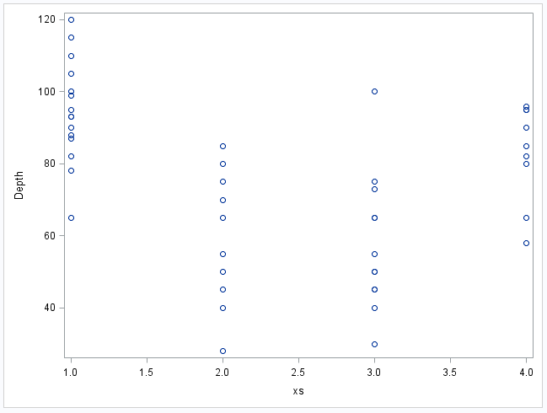
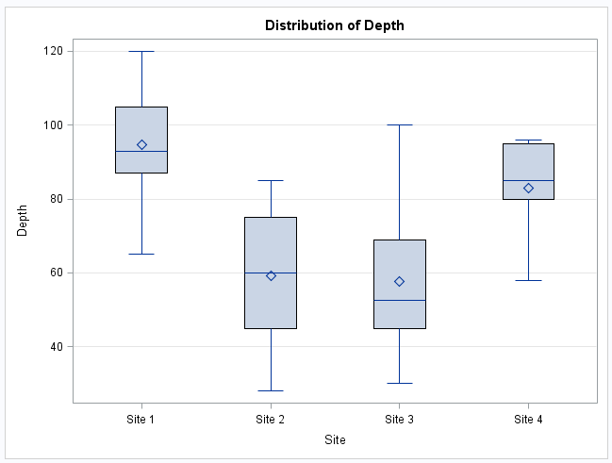
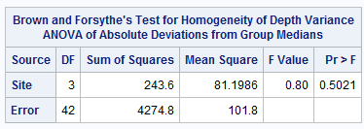
Archeology Example Assumptions: Homogeneity (Equal SD)
proc glm data = archeology; class site; model depth = site; means site / HOVTEST = BF t; run;

Slide 6
Archeology Example Assumption: Independence
The discovered artifacts associated with the depths were randomly selected from the log (book of recordings … not logarithms!) of discoveries.
Since the artifacts and, thus, the depths are associated with completely different sites, it is assumed that the data are independent between sites.

Slide 7
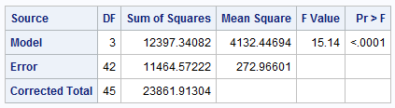
First Ask: Is there reason to believe any of them are different?
H₀: The mean depths of the artifacts are equal for each of the sites.
H_{A}: At least one pair of sites have different mean depths
There is strong evidence to suggest that at the alpha = .05 level of significance (p-value < .0001 from an ANOVA) that at least 2 of the sites have different mean depths.

Slide 8
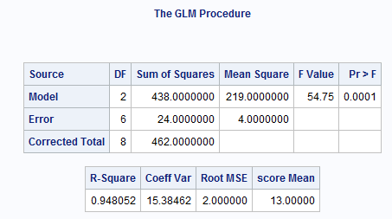
Archeology Example 6 Steps for ANOVA F Test (diff means)
1.
H₀: µ₁= µ₂ = µ₃ (Equal Means Model)
H_{a}: At least 1 pair are different (Separate Means Model)
2.
Critical value: F statistic with numGroups -1 and N-numGroups d.f. at alpha = 0.05
3.
F statistic = 54.75
proc glm data = archeology; class site; model depth = site; means site / HOVTEST = BF t; run;
4.
P-value = .0001
5.
Reject H₀.
6.
The evidence suggests that at least 1 pair of the group means are different. (P-value < .0001 from an ANOVA.)

Slide 9
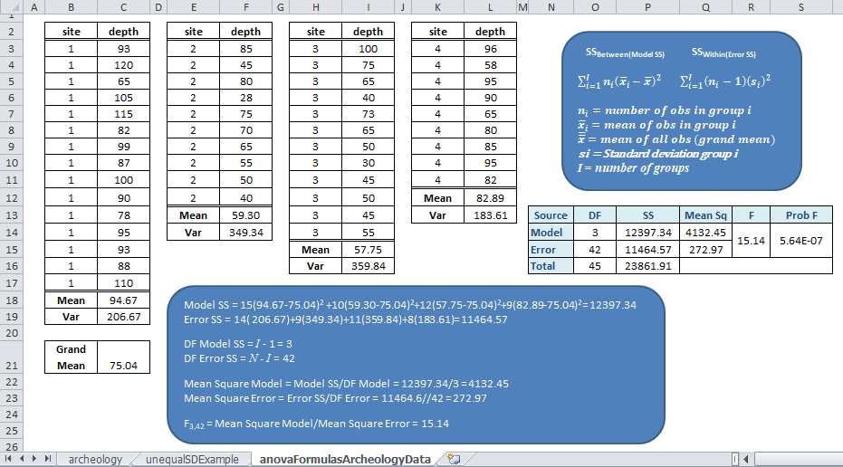
Archeology Example ANOVA Formulas

Slide 10
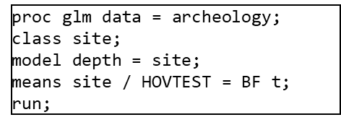
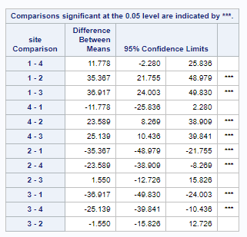
Now Look for Differences Between Group Using t-Statistic

Slide 11
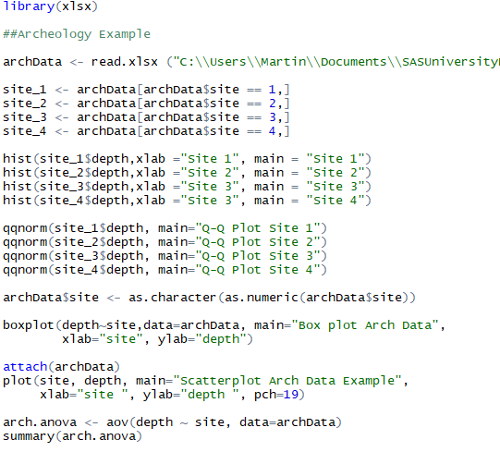
SAS and R Code for Archeology Example

Slide 12
Unequal Standard Deviations in Groups (You need this for the homework)
Assumption violated
Visual Tests
Box pots
Scatter plots
Brown and Forsythe's Test for Homogeneity of Variances
Non-parametric group means test:
Kruskill-Wallis Test
Parametric group means test:
Welch Test

Slide 13
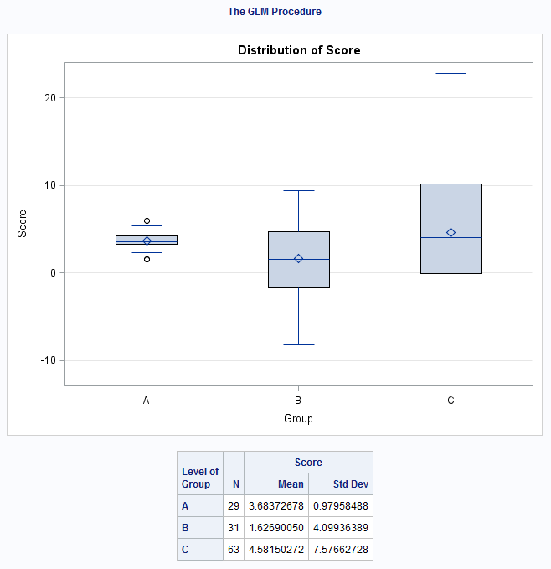
Unequal SD Example: Data, Means, StdDev, Boxplot
More obs for C
Level of group | N | score
 |  | Mean | Std Dev
A | 29 | 3.89619924 | 0.85209553
B | 31 | 1.97744181 | 4.10639231
C | 63 | 4.87526737 | 7.04876351

Slide 14
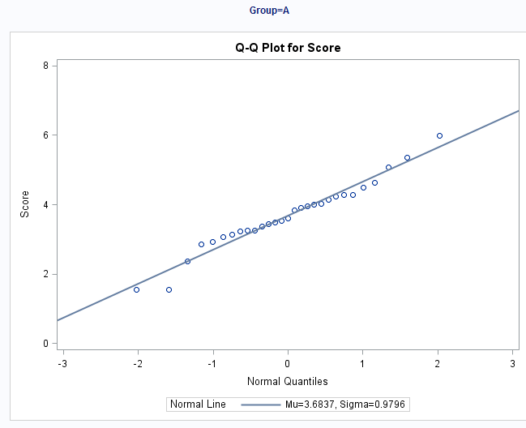
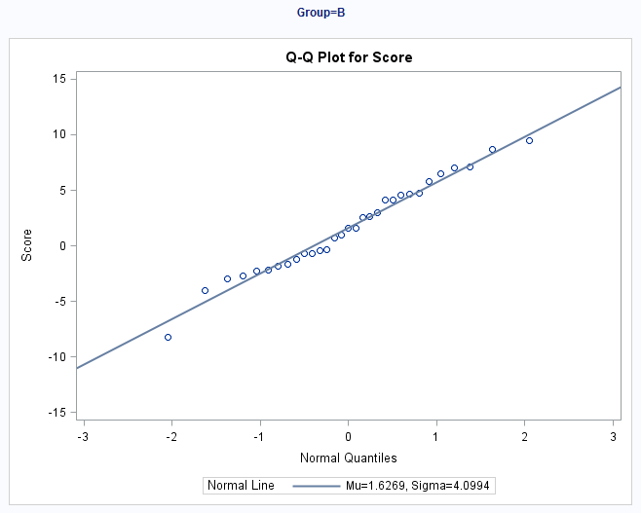
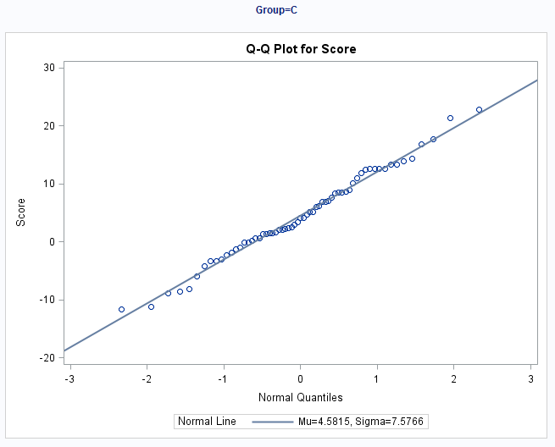
Normality Assumption
There is strong evidence in favor of these data coming from a normal distribution. We will proceed under this assumption.

Slide 15
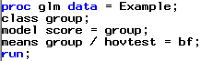
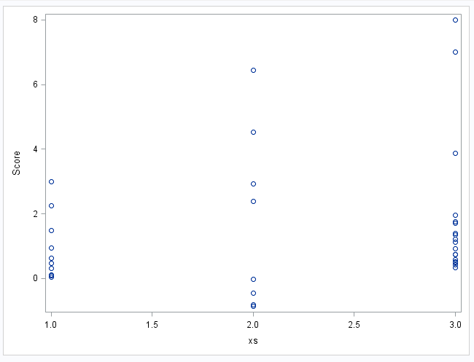
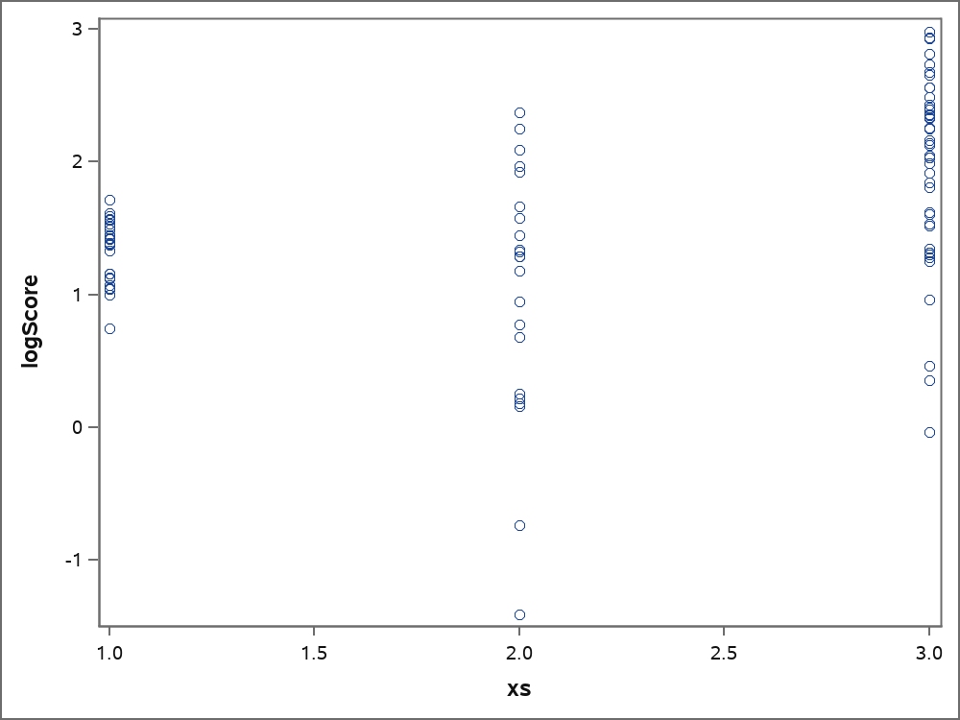
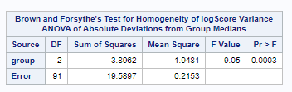
Unequal SD Example: Homogeneity of Variance Assumption
Original Data
Brown and Forsythe's Test for Homogeneity of score Variance ANOVA of Absolute Deviations from Group Medians
Source | DF | Sum of Squares | Mean Square | F Value | Pr > F
group | 2 | 547.4 | 273.7 | 28.74 | <.0001
Error | 120 | 1142.6 | 9.5220
Use the log of score
proc glm data = unequalSd; class Group; model logScore = Group; means Group / HOVTEST = BF Welch t ; run;
There is some evidence in support of these data coming from distributions with different standard deviations. Taking logs does not help. If the standard deviation assumption is violated, what should we do?

Slide 16
Unequal SD Example: Do not do ANOVA Assuming Equal SDs For Groups
There is some evidence in support of these data coming from distributions with different standard deviations. Taking logs does not help. If the standard deviation assumption is violated, what should we do?
ANOVA Assuming Equal SDs For Groups
Source | DF | Sum of Squares | Mean Square | F Value | Pr > F
Model | 2 | 174.481376 | 87.240688 | 2.90 | 0.0587
Error | 120 | 3606.677758 | 30.055648
Corrected Total | 122 | 3781.159135

Slide 17
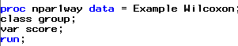
Unequal SD Example: Welch's ANOVA and Kruskal-Wallis Test
Welch's ANOVA for score
Source | DF | F Value | Pr > F
group | 2.0000 | 3.89 | 0.0261
Error | 58.0646
Kruskal-Wallis Test
Chi-Square | DF | Pr > ChiSq
6.2692 | 2 | 0.0435
There is sufficient evidence at the alpha = .05 level of significance (p-value = .3766 from Kruskal-Wallis Test) to suggest that at least two of the medians are different.
Notice that each test rejected their respective H_{o}. The point isn’t so much that one test will reject when the other will fail to reject. We must remember that as statisticians, we don’t personally favor one outcome over the other. We just want the appropriate test: the one with the most power. Kruskal-Wallis Test is the appropriate test.

Slide 18
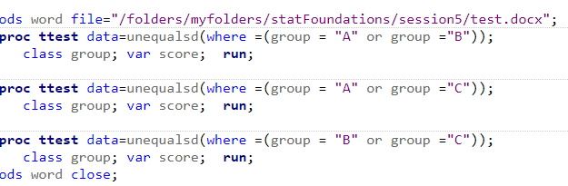
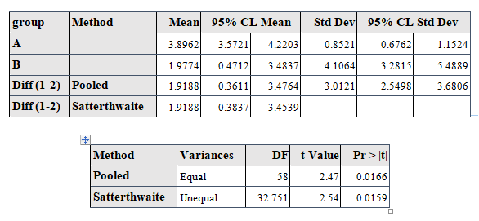
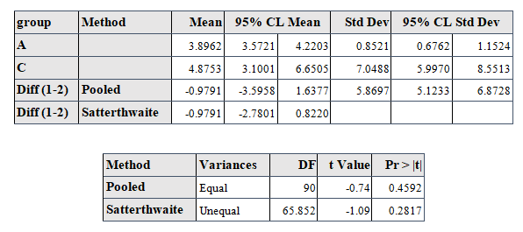
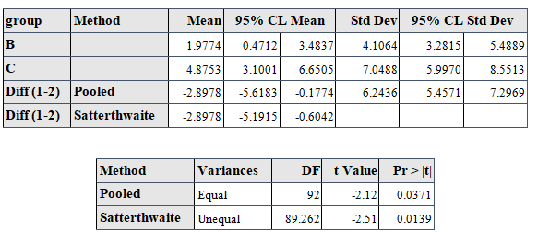
Conduct Welch T Tests to Evaluate Differences Between Groups

Slide 19
SAS and R Code unEqual Example
See also slide 19

Slide 20
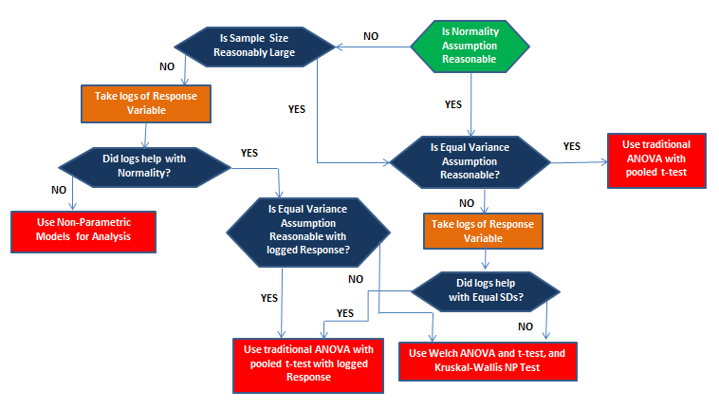
Flowchart for Analyzing Continuous Response and Categorical Variables with ANOVA

Slide 21
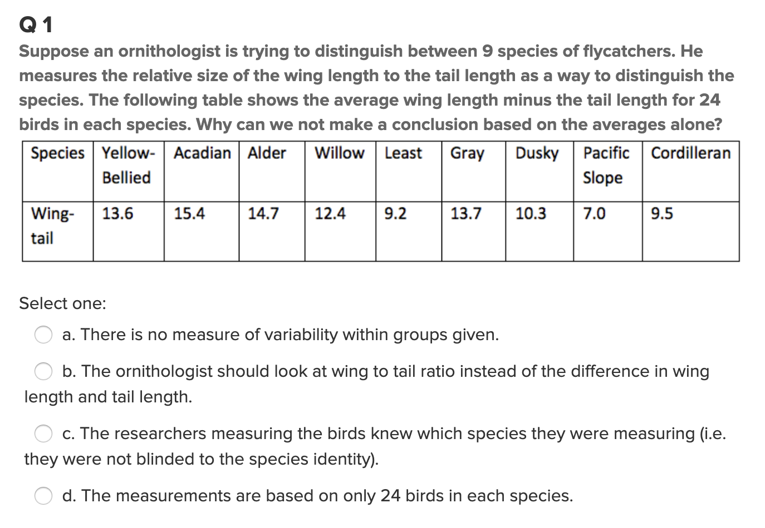
Quick Quiz Question 1 (<15 min)

Slide 22
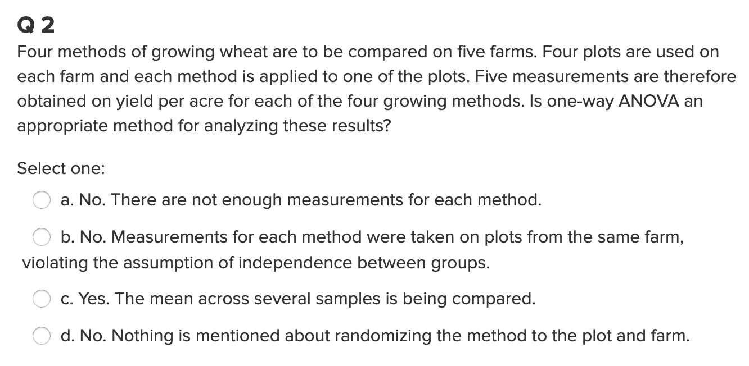
Quick Quiz Question 2 (< 15 min)

Slide 23
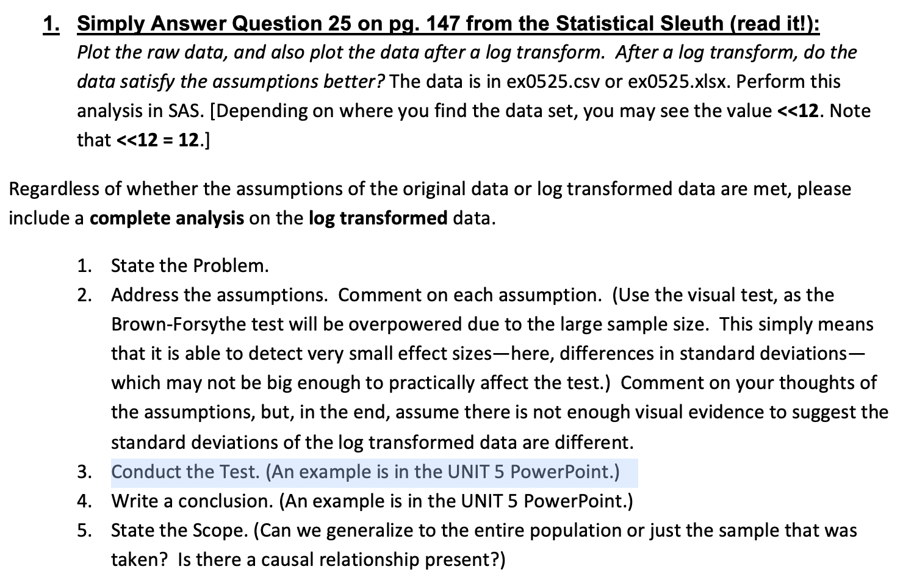
Question 1 ( < 2 hours )
Also, in Session5Data.xlsx
Note Well: Because of the large sample sizes, we can use the Central Limit Theorem and assume normality of sample means.

Slide 24
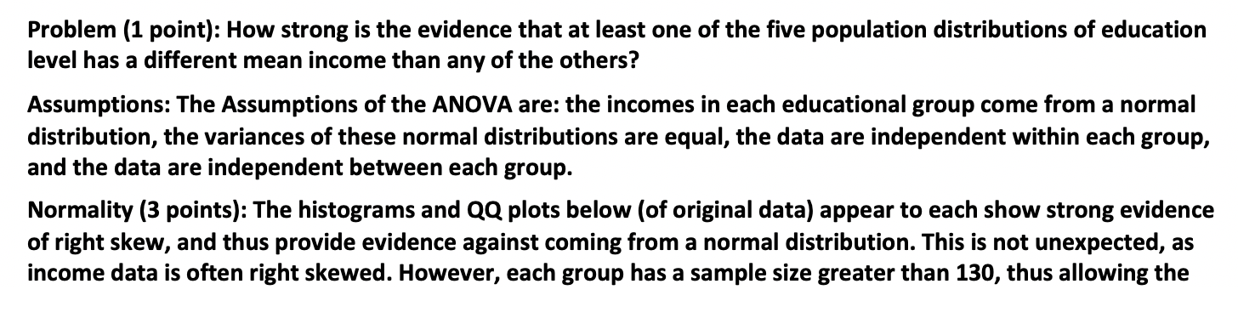
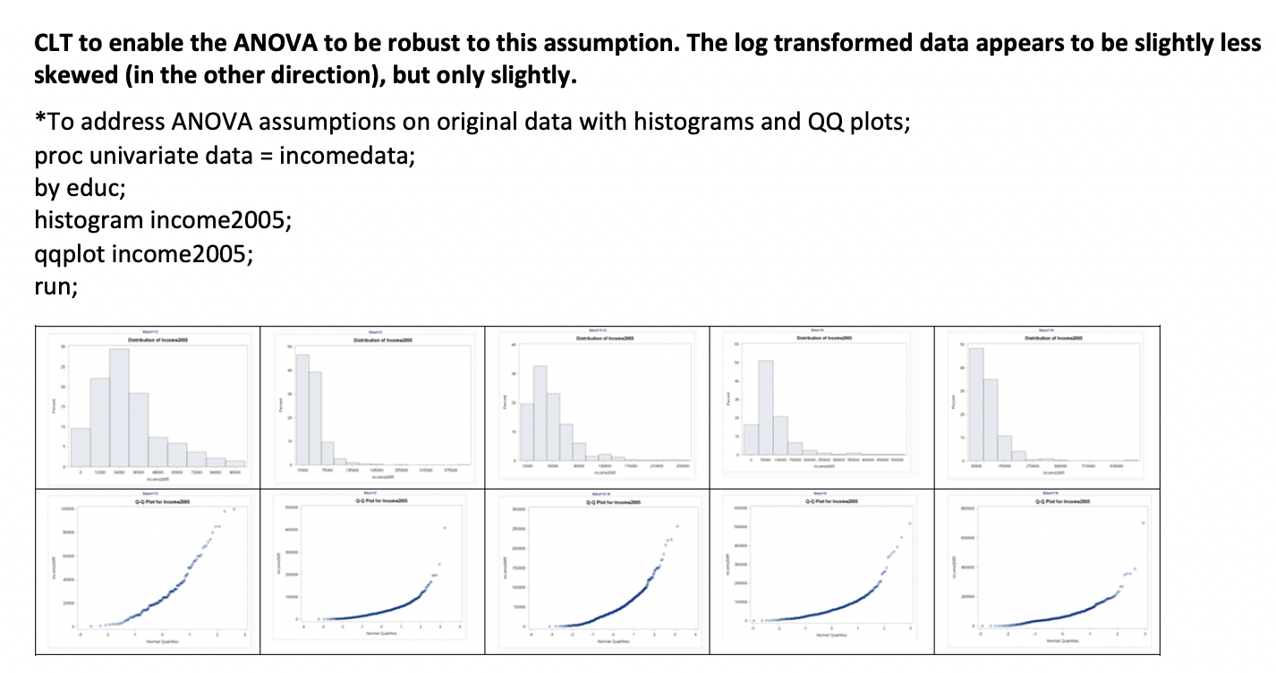
Question1: Solution (Normality Assumption)

Slide 25
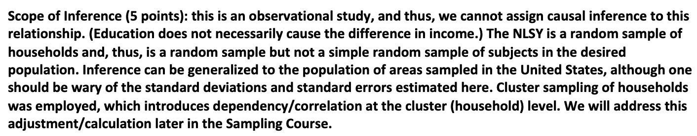
Question1: Solution Scope of Interest

Slide 26
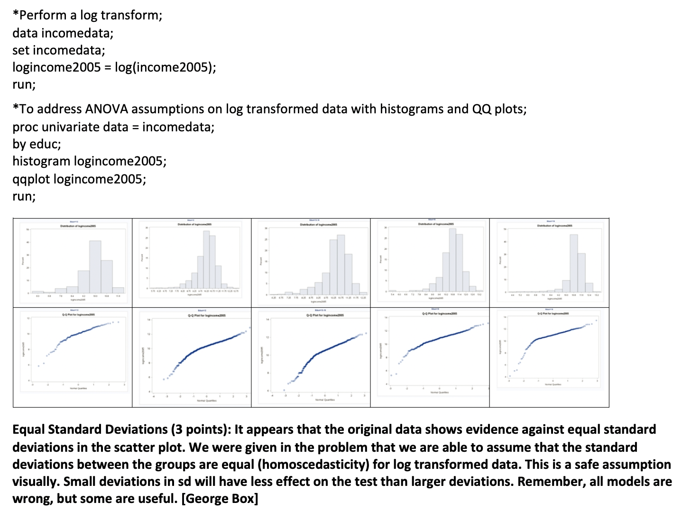
Question1: Solution (Equal Standard Deviations Assumption – histogram, qqplot )

Slide 27
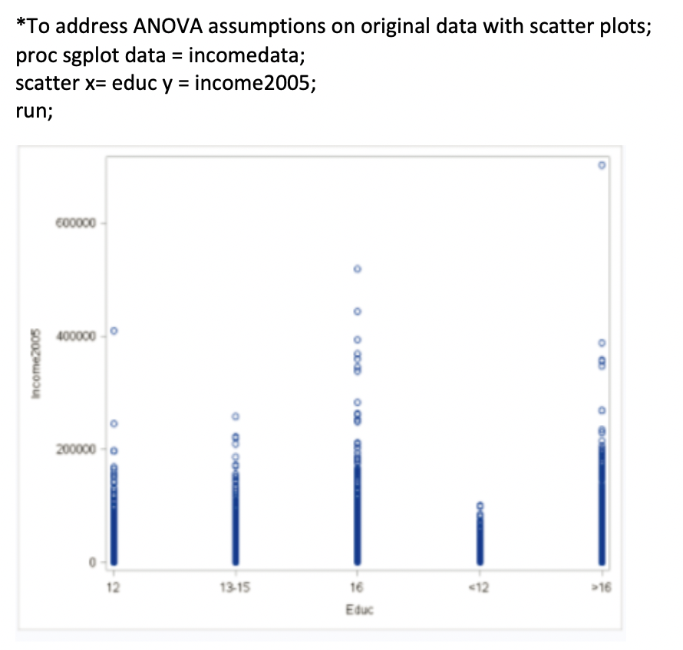
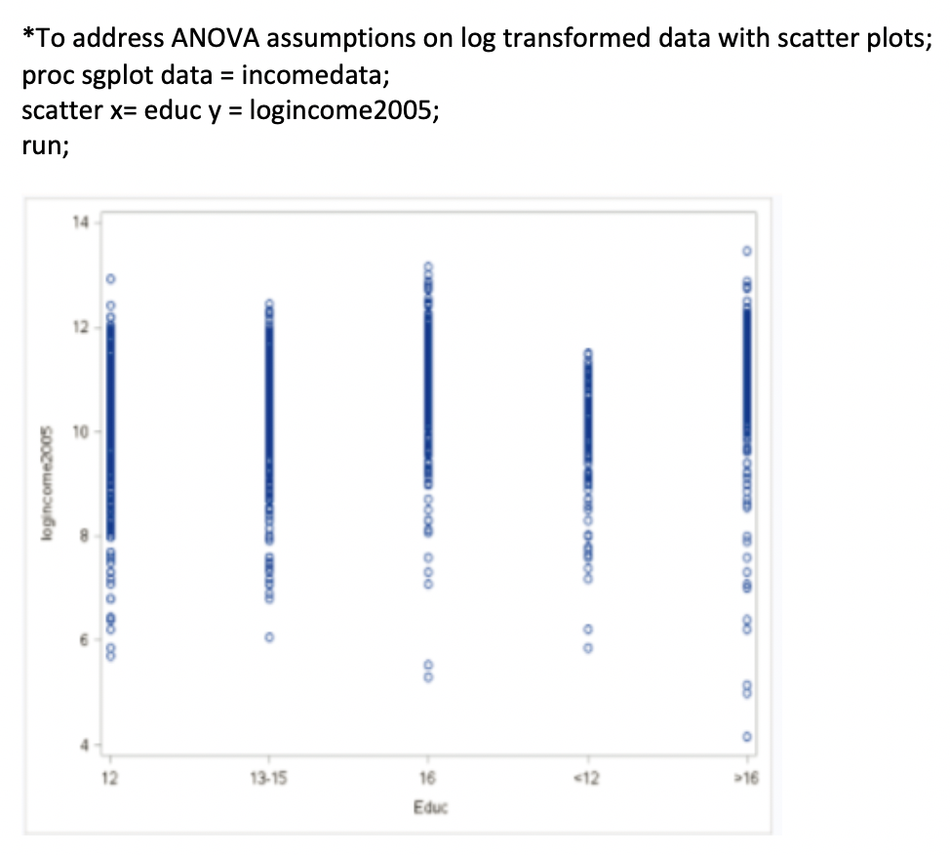
Question1: Solution (Equal Standard Deviations – scatter plot)

Slide 28
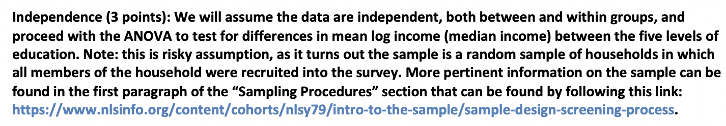
Question1: Solution Independence

Slide 29
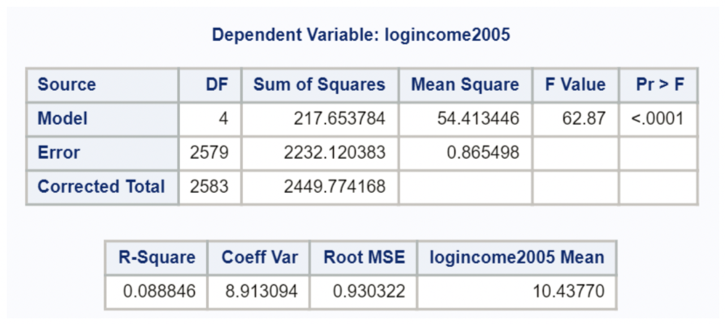
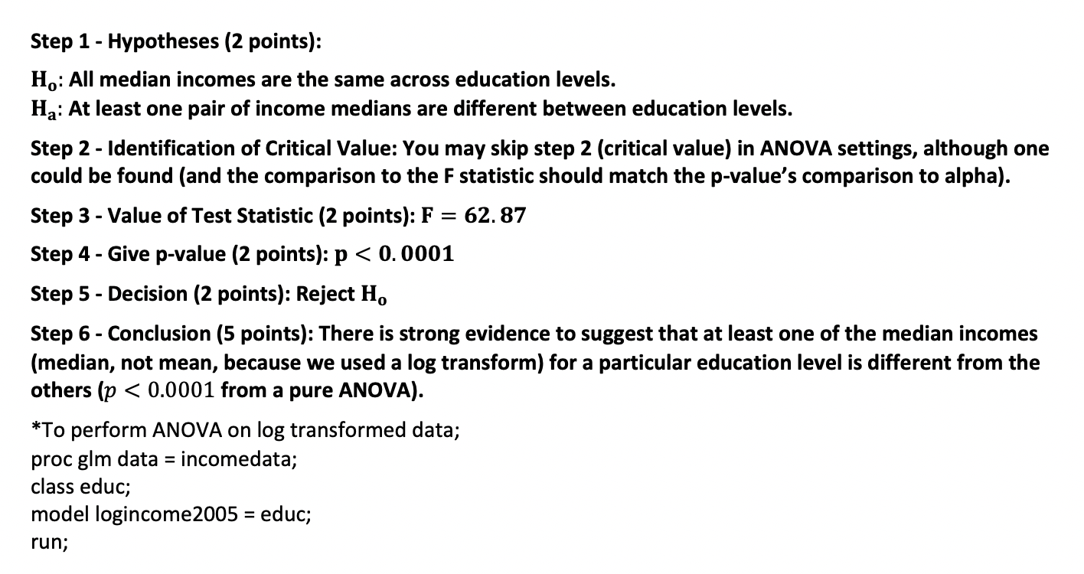
Question1: Solution ANOVA
Keep in mind the log transformation, so we are testing medians

Slide 30
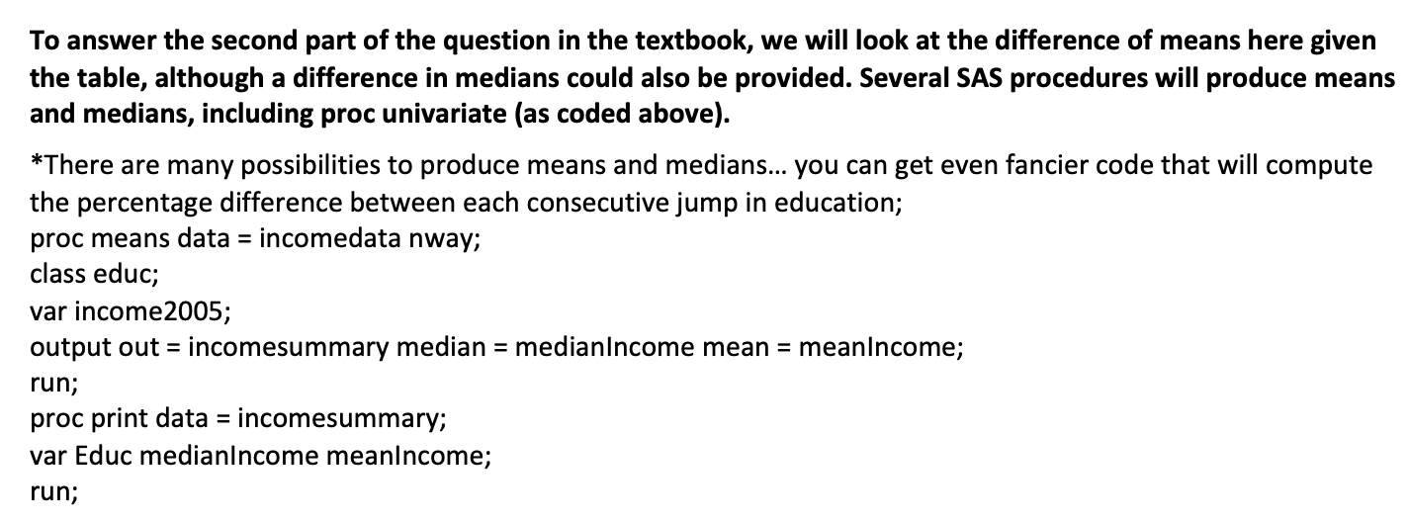
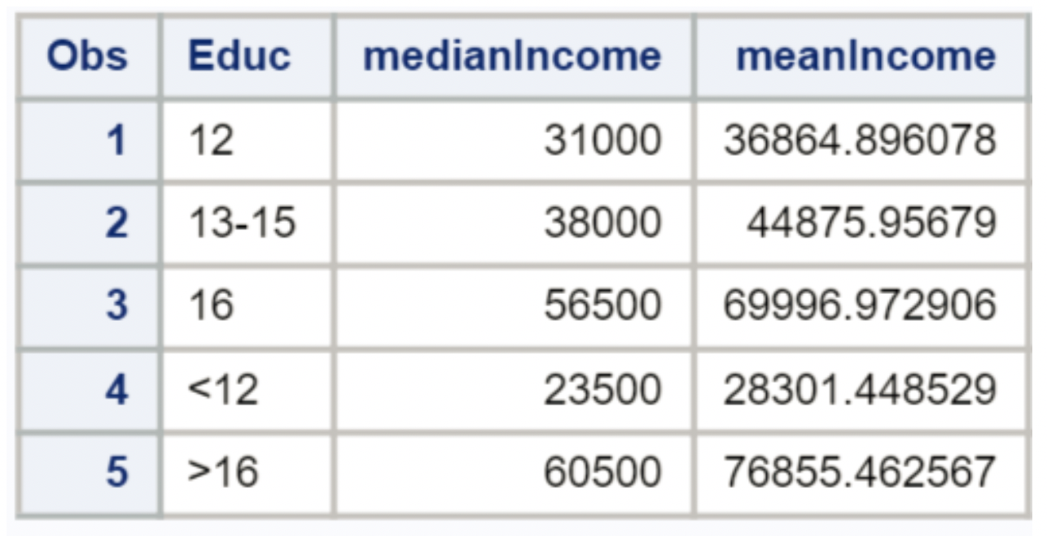
Quesion1: Solution Mean and Medians in Groups Differ?

Slide 31
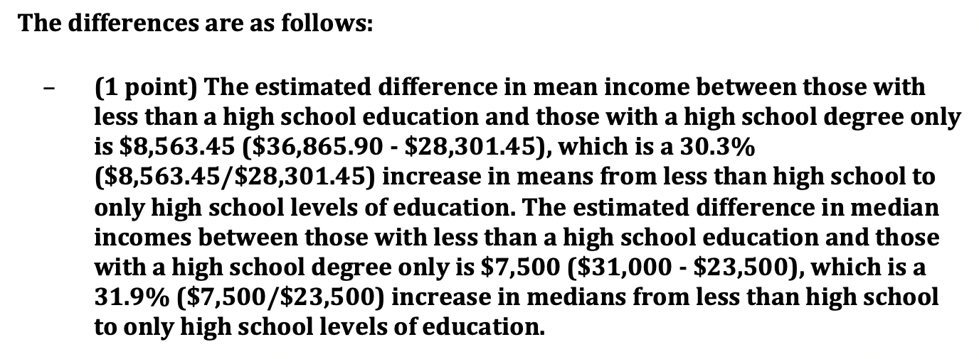
Quesion1: Solution Mean and Medians in Groups Differ? - Continued
Not logs here!

Slide 32
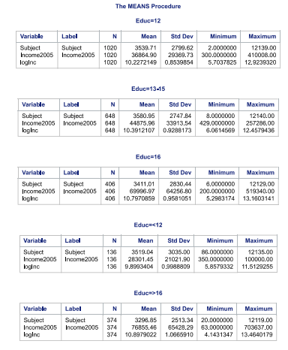
Quesion1: Solution Compare Medians With t Tests
Logs here!

